Slide 1
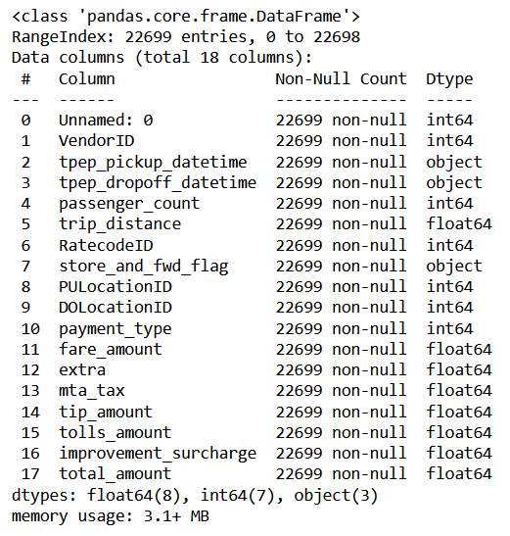
Understanding the TLC data
A preliminary analysis of the taxi fare data provided by TLC
TLC provided a dataframe which was investigated for the first time. Below are the key observations made during this preliminary analysis.
While the dataset provided does not contain any null values, some negative values are contained in the columns that relate to the fare amounts, and some trip distances are equal to 0. There is also one extreme fare amount value that seems abnormal.
The record for the extreme fare amount should be excluded from the dataset. The records with negative values should either be excluded or the sign of the values switched. The records with a trip distance of 0 should be excluded if trip distance is used.
The dataset provided by TLC contains 18 columns in total.
The first column is missing its name, but it turns out to be the trip ID.
There are 20 records for which the fare amount is less than or equal to 0.
There are 148 records for which the trip distance is 0.
The extreme fare amount value is $999.99, which seems to be a dummy value.
The following columns have been identified as not relevant for estimating the fare amount:
VendorID
Store_and_fwd_flag
All fare-related variables apart from fare_amount
Output of the info method applied on the TLC dataframe.
Before carrying out further data exploration, the rows of abnormal records mentioned above should be removed. Also, the columns containing data that is irrelevent to the goal of the project can be removed to reduce the size of the dataframe.

